Slide 1
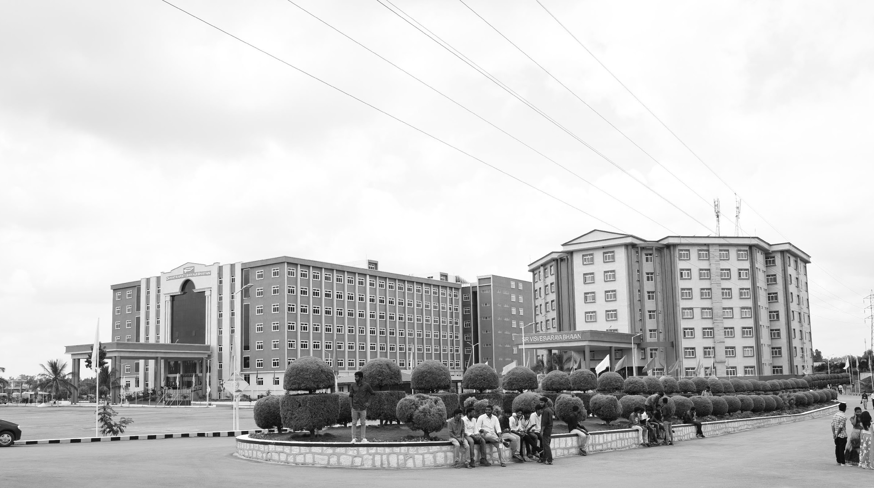

AUTONOMOUS NAVIGATING AND INTERACTING ROBOT
Mid-Review - 3
Major Project
Project ID: CS-15
AY 2021-25
GITAM (Deemed-to-be) University
Project Team:
K.SAI GANESH REDDY-BU21EECE0100566
M.RAVI KIRAN REDDY-BU21EECE0100516
G.PRADEEP REDDY-BU21EECE0100084
Department of Electrical Electronics and Communication Engineering
Project Mentor:
M Dioline Sara
Project In-charge:
Pankaj Kandhway
www.gitam.edu

Slide 2
Objective and Goals
Objective
Building on the work from the previous semester, which focused on simulations in virtual environments using tools like Gazebo and ROS, we developed a hardware-based GRID SLAM autonomous robot. This project transitioned from simulations to actual hardware implementation, integrating components such as LiDAR sensors and cameras for real-time mapping and localization. Advanced GRID SLAM algorithms were utilized to enable the robot to create maps and localize itself in unknown environments without relying on pre-defined maps.
By combining real sensor data with probabilistic techniques, the system achieved efficient path planning, dynamic obstacle avoidance, and adaptability to real-world indoor environments. Initial testing demonstrated the robot's ability to perform autonomous navigation and mapping effectively. Efforts were concentrated on optimizing the system for energy efficiency, real-time performance, and reliable operation.
Goals
Main Goals
Enable real-time autonomous navigation using LiDAR and cameras.
Ensure accurate localization of the robot's position and orientation.
Achieve efficient path planning and dynamic obstacle avoidance.
Transition GRID SLAM algorithms from simulation to hardware implementation Additional Goals
Additional Goals
Integrate IMUs and other sensors for enhanced accuracy and redundancy.
Create real-time visualization tools for the robot's path and map.
Optimize the system for energy efficiency and real-time performance.

Slide 3
Project Plan
Research and Planning | 3 Weeks
System Design | 6 Weeks
Development and Prototyping | 8 Weeks
Testing and Validation | 5 Weeks
Deployment and Documentation | 2 Weeks

Slide 4
Literature Survey
S.No | Title | Methodology | Merits | Research | Year of Published
1. | Autonomous Navigation by Mobile Robots in Human Environments: A Survey | This research will focus on recent advancements in autonomous navigation for robots in human environments, categorizing approaches into Reactive, Predictive, Model-based, and Learning-based strategies. Finally, we’ll outline future research needs, including human behavior prediction, efficient pathfinding, and socially aware navigation. | 1.Provides a clear categorization of navigation approaches. 2.Highlights strengths and limitations of each method. 3.Uses specific metrics for easy comparison. 4.Identifies gaps in current research | This research reviews how robots navigate around people, examining different methods and their pros and cons. It compares approaches like reactive and predictive planning, using metrics like safety and efficiency. | 2018 IEEE International Conference on Robotics and Biomimetics (ROBIO)

Slide 5
S.NO | Title | Methodology | Merits | Research | Year of Published
2. | Research on Autonomous Robots Navigation based on Reinforcement Learning | Autonomous robot navigation is a complex task that requires robots to autonomously plan paths and avoid obstacles in unknown or dynamic environments. Reinforcement learning has shown great potential in this field as a trial-and-error learning method. | 1.Adapts to changing environments. 2. Reduces collisions effectively. 3.Navigates without prior maps. 4.Maintains stable, efficient learning. | This research explores how reinforcement learning can help robots navigate complex environments by learning from their interactions. Through experiments, the study shows these methods enhance the robots' navigation performance and adaptability. | Wed, 14 Aug 2024 04:49:22 UTC

Slide 6
S.NO | Title | Methodology | Merits | Research | Year of Published
3. | Online trajectory prediction and planning for social robot navigation | The methodology involves a novel motion model that predicts and coordinates the trajectories of mobile robots and humans during encounters. It utilizes timed elastic bands (TEB) for online trajectory planning, incorporating proxemic objectives to optimize paths while maintaining safe distances. | 1.Improved Safety: Enhances collision avoidance in crowded environments. 2.Natural Interaction: Facilitates more intuitive and legible robot behavior around humans. 3.Real-time Adaptability: Allows dynamic trajectory adjustments based on real-time interactions. | This research focuses on how mobile robots can navigate safely in crowded spaces by predicting and planning their movements around humans. It uses a method called timed elastic bands to create flexible paths while considering human behavior and proxemics. | 2017 IEEE International Conference on Advanced Intelligent Mechatronics (AIM) Sheraton Arabella Park Hotel, Munich, Germany, July 3-7, 2017

Slide 7
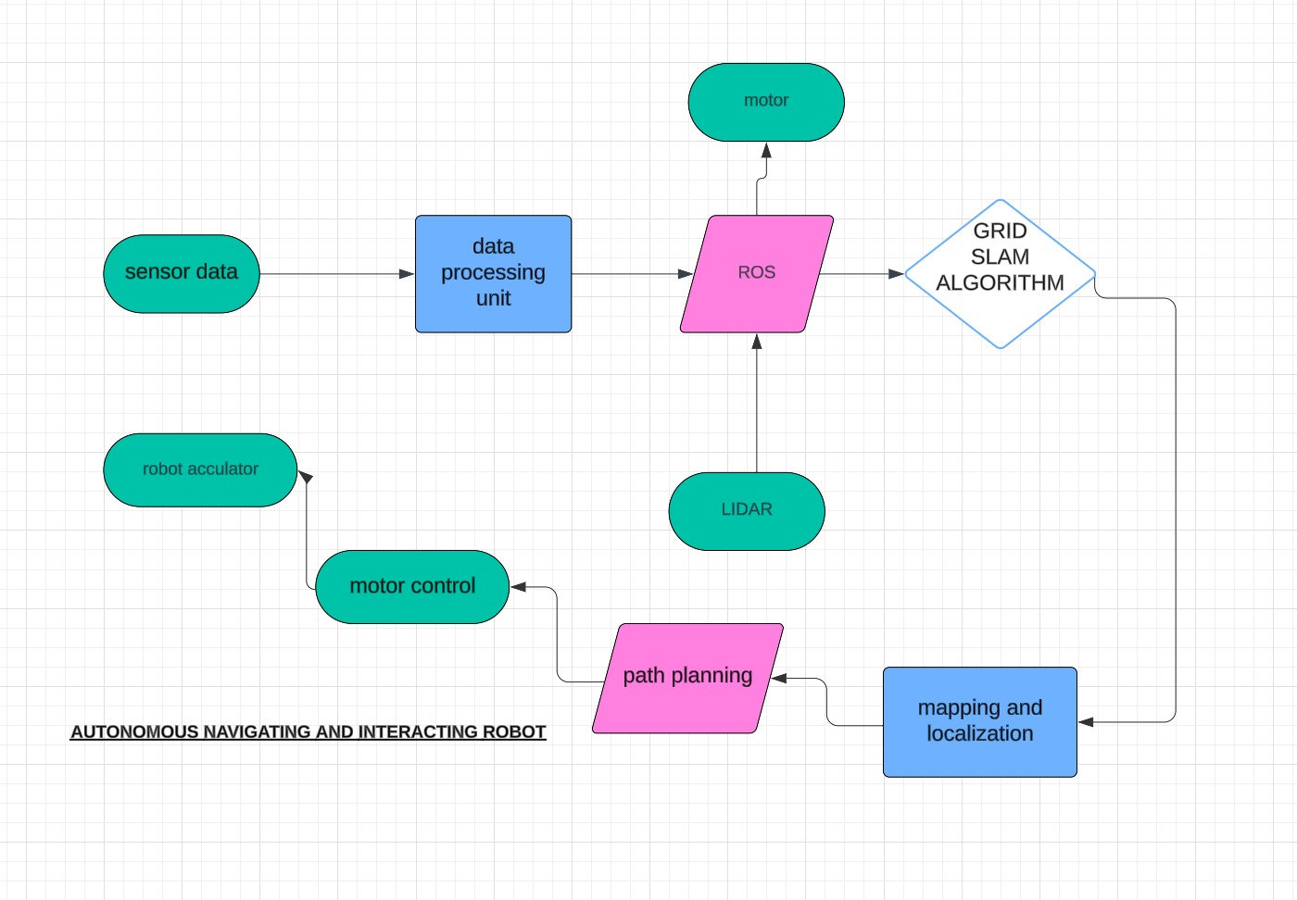
Architecture

Slide 8
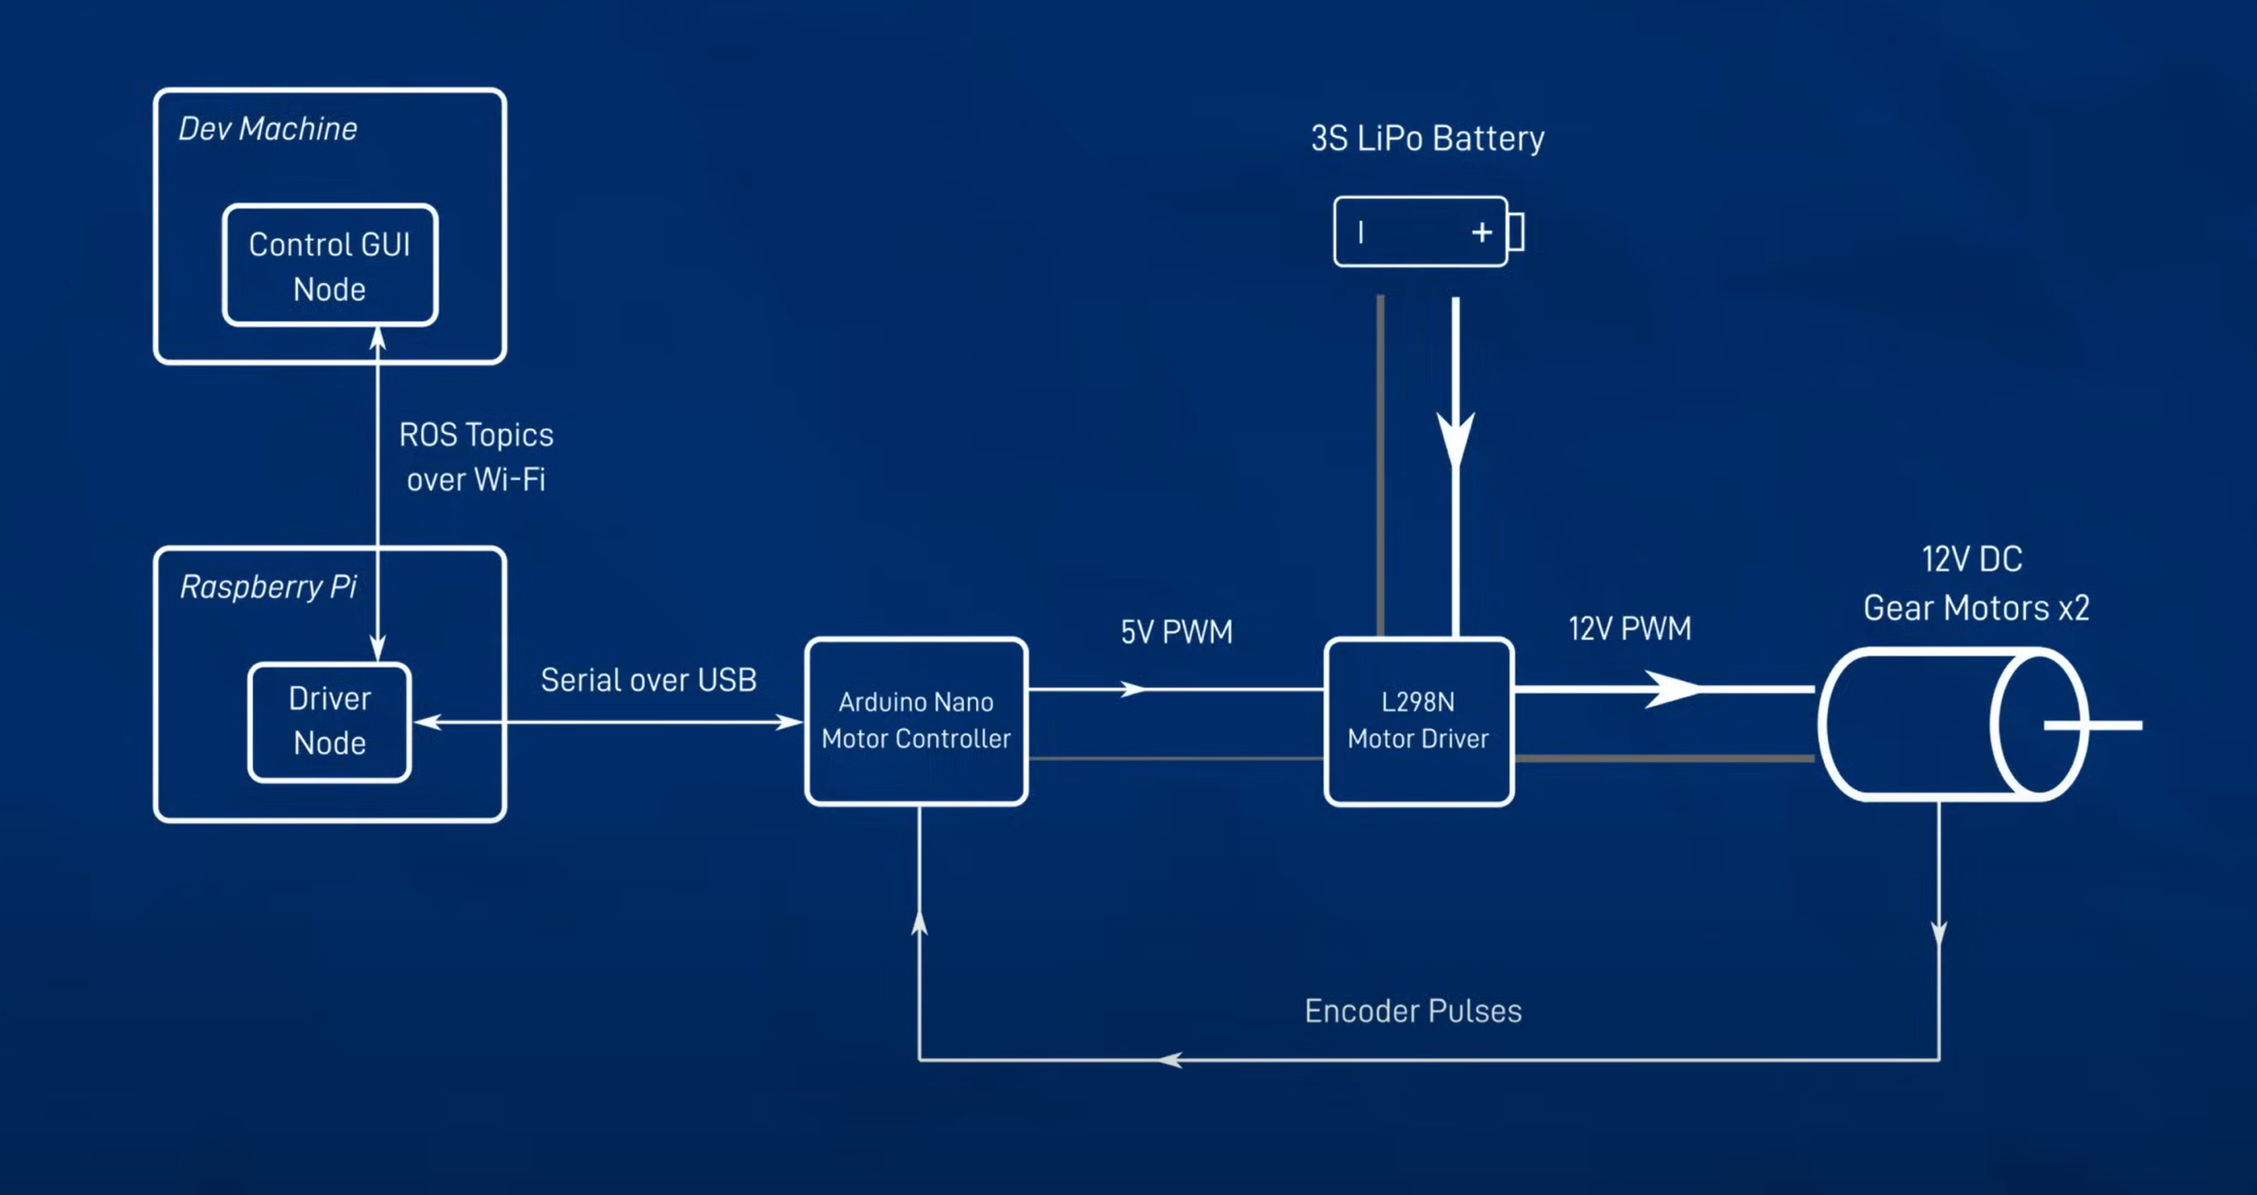

Slide 9
Use Cases & Testing
Use Cases
Navigate complex indoor environments like offices and malls.
Autonomous Delivery
Surveillance
Cleaning Robots
Test Cases
Mapping Accuracy:
Verify if the robot can create accurate maps of a given indoor environment.
Localization Consistency:
Test the robot’s ability to consistently localize itself in the mapped environment, even after movement or turning off/on.
Obstacle Avoidance:
Place dynamic obstacles in the path and ensure the robot can detect and navigate around them.
Path Planning:
Test if the robot can plan and execute an optimal path from one point to another without collisions.

Slide 10
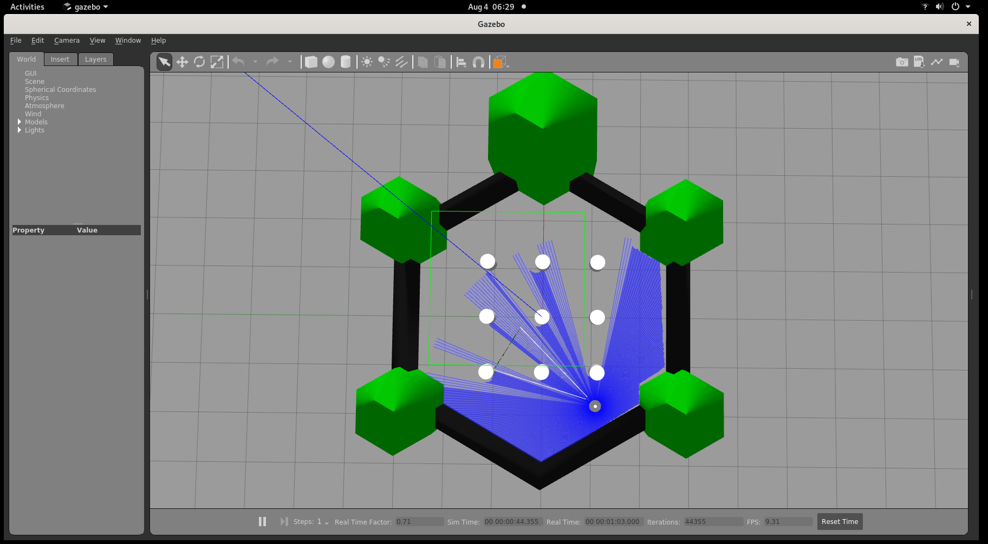
Implementation and Results – Iteration 1

Slide 11
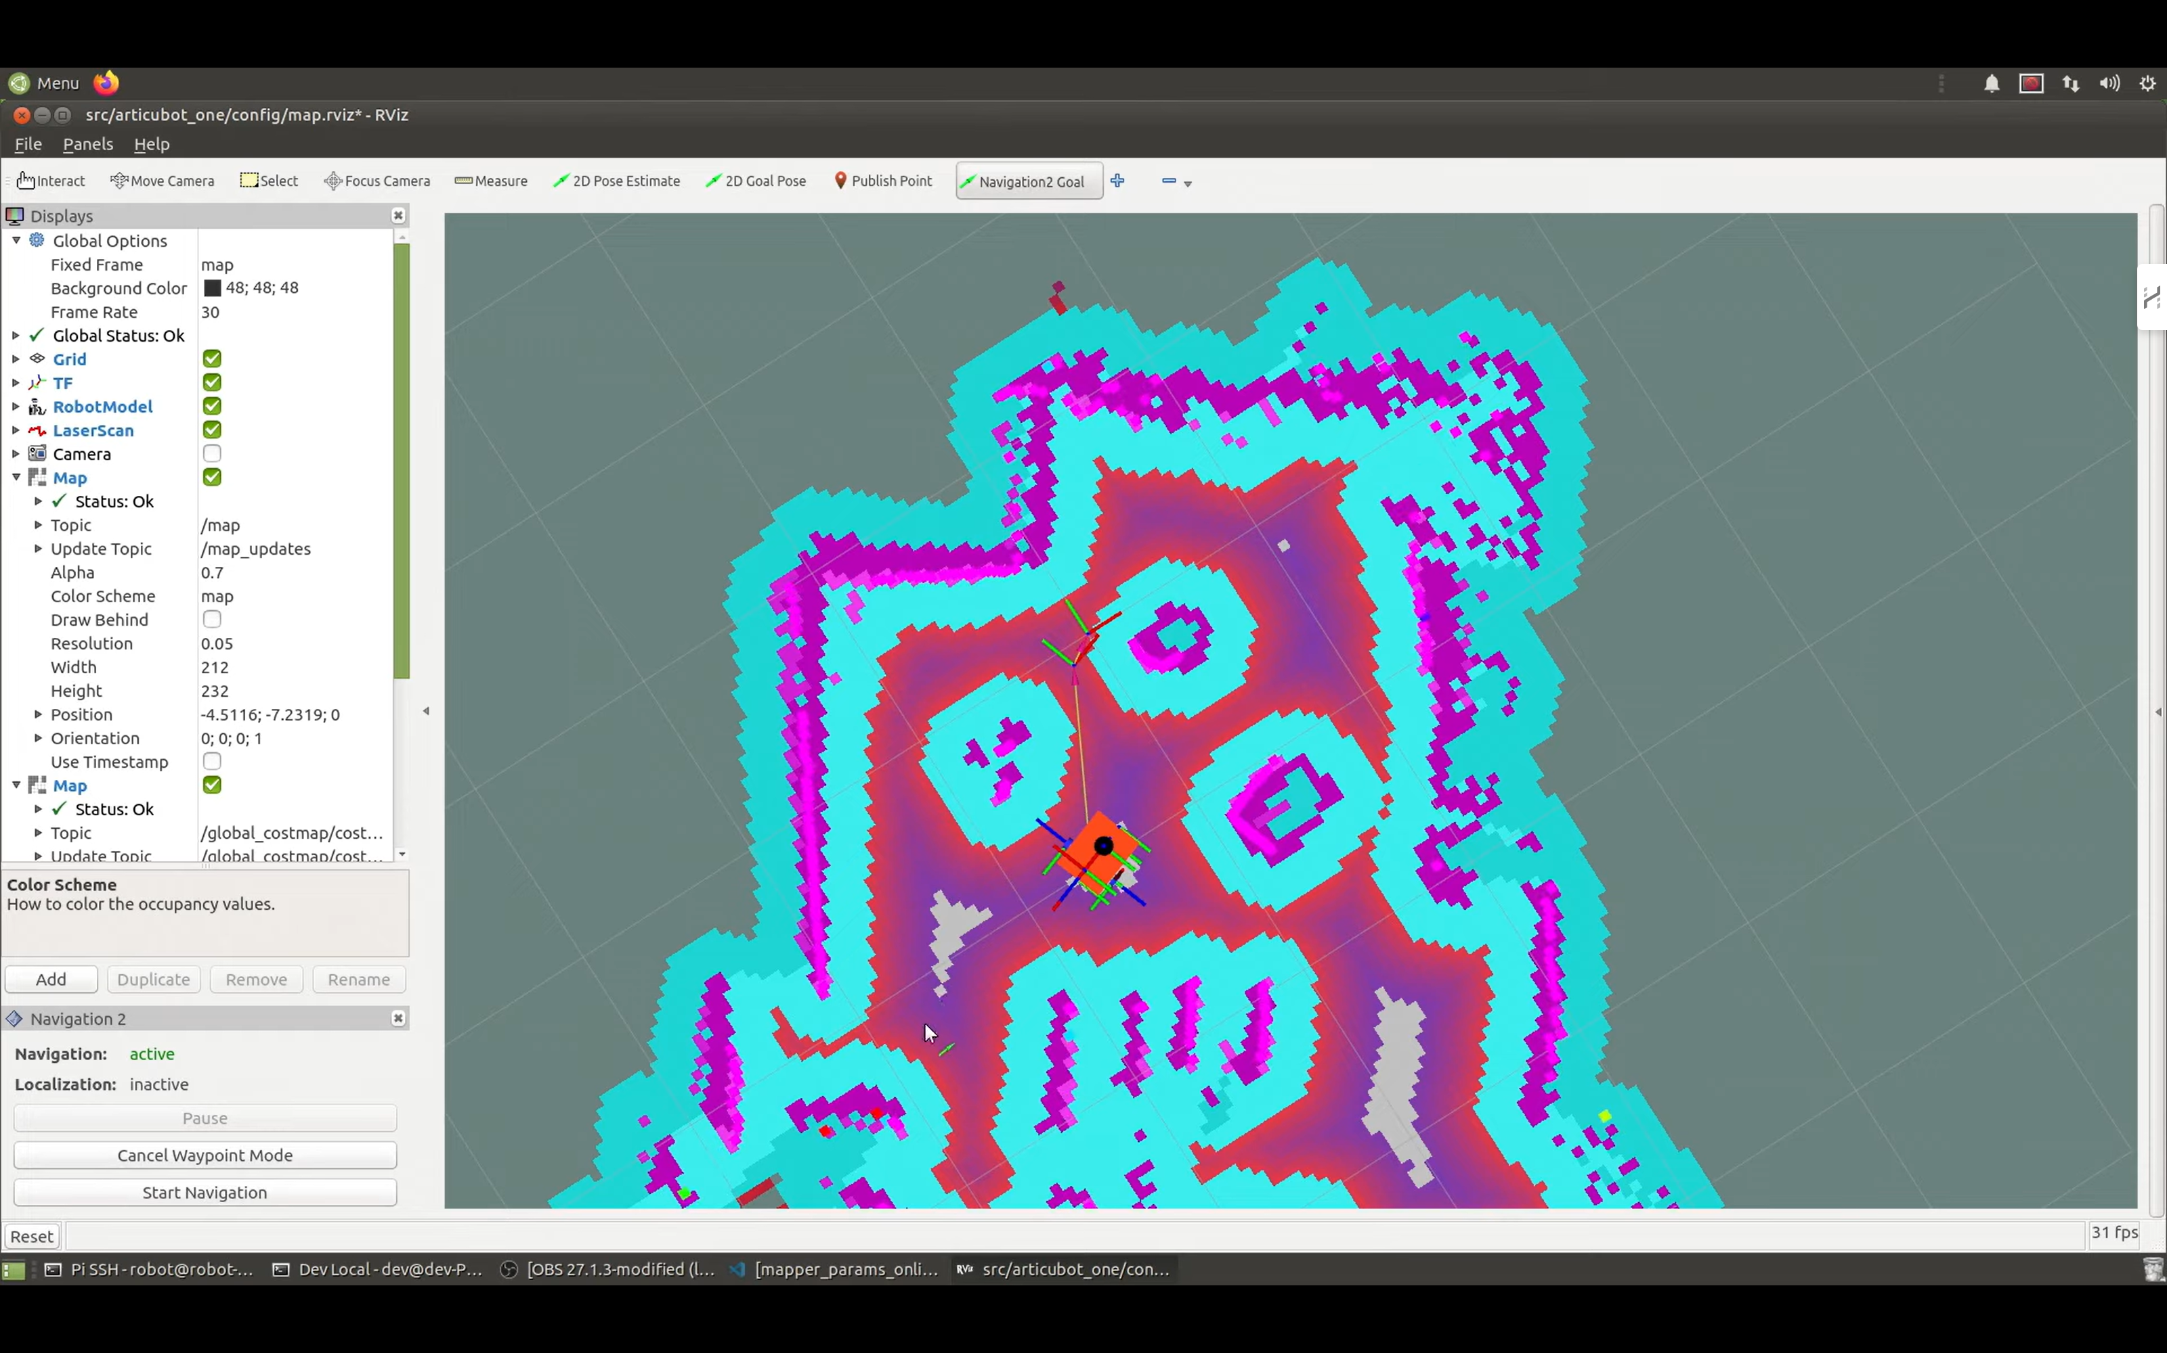
Implementation and Results – Iteration 2

Slide 12
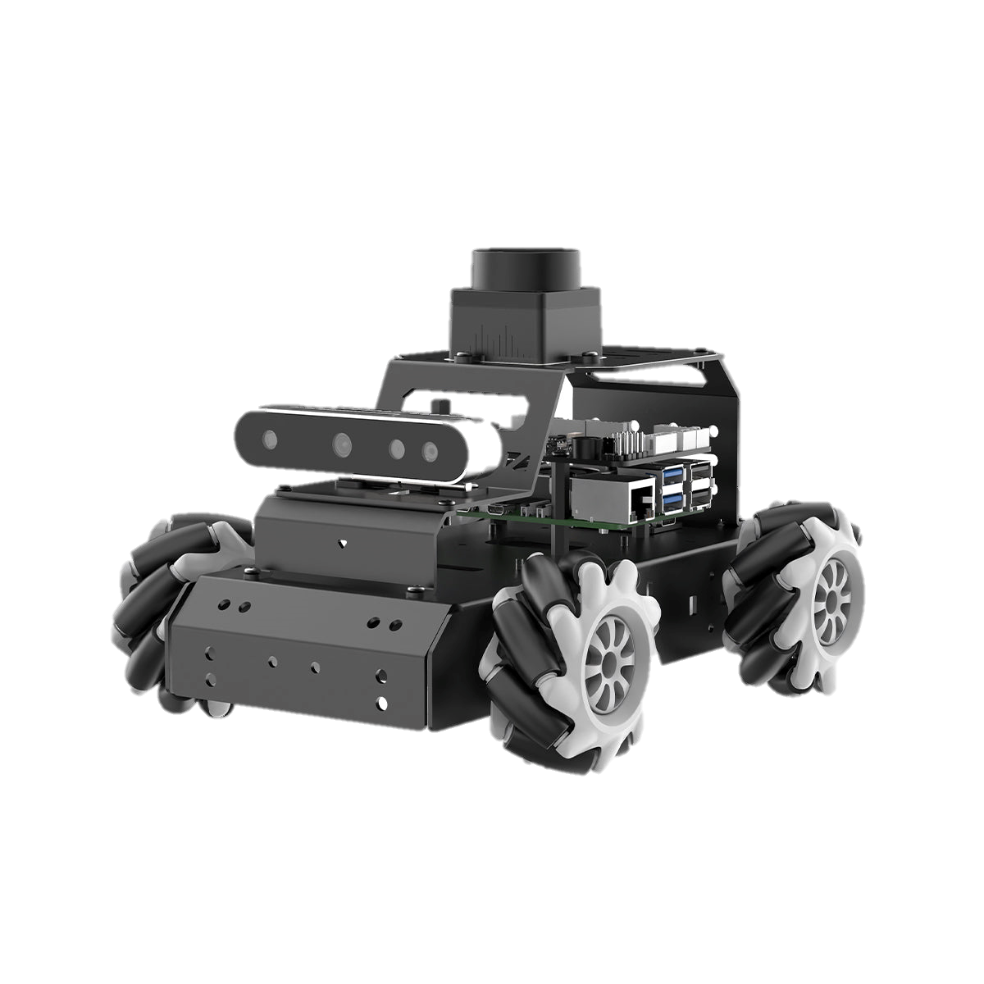
Implementation and Results – Iteration 3 (Optional)

Slide 13
Contribution
Team Progress and Movement
Exploring new software tools and gaining a deeper understanding of how individual components function.
Tackling and resolving new challenges as they arise.
Creating comprehensive documentation and reports for the project.
Collaborating with mentors and experts to gather insights and feedback.
Conducting weekly team meetings to review progress, address challenges, and plan for upcoming tasks.
Implementing real-time monitoring and self-healing capabilities to ensure system stability.
Individual Contribution
Key contributions: K.Sai Ganesh Reddy
Hardware Setup
Research and Development
Key contributions: M.Ravi Kiran Reddy
Analysis
Documentation
Key contributions: G.Pradeep Reddy
Literature survey
External works

Slide 14
Conclusion & Future Work
Summary and Conclusion
This project highlighted the potential of GRID SLAM in enhancing autonomous robots’ real-time mapping and navigation capabilities. The system proved to be effective in structured environments, demonstrating efficient localization and path planning. However, for broader applications, future improvements like multi-sensor integration, scalability for outdoor environments, and AI-driven decision-making are essential. These upgrades will broaden the scope of GRID SLAM, enabling its use in dynamic real-world scenarios and accelerating advancements in autonomous robotics across various industries.
Future Work
Enhance GRID SLAM performance in dynamic and unstructured environments, ensuring robust localization and mapping capabilities even in rapidly changing conditions.
Integrate multi-sensor fusion (e.g., LiDAR, IMU) to enhance localization accuracy, enabling more precise mapping and real-time decision-making.
Develop advanced algorithms for autonomous navigation and obstacle avoidance, improving the robot's ability to navigate complex terrains and avoid potential collisions.
Adapt GRID SLAM for outdoor environments by incorporating GPS integration, expanding its use to real-world scenarios with large-scale, open spaces.
Optimize hardware efficiency to ensure prolonged autonomous operation, enhancing battery life and system reliability in various tasks.
Apply GRID SLAM technology to diverse fields such as agriculture, delivery services, and warehouse automation, enabling transformative impacts in these industries.

Slide 15
THANK YOU
Have a Great Day !

